Slide 1
Microphone Control Service(MICS) Introduction
Chunhao Jiang, CSPD
Feb, 2024

Slide 2
Content
Introduction
Service
Notes:
这是说

Slide 3
Introduction
There shall be no more than one instance of MICS instance on a device.
MICS is declared on devices that can control the mute state of a microphone’s audio
MICS shall be a Primary Service or Secondary Service
MICS may include zero or more instances of AICS.
MICS provides global, device-wide, mute control

Slide 4
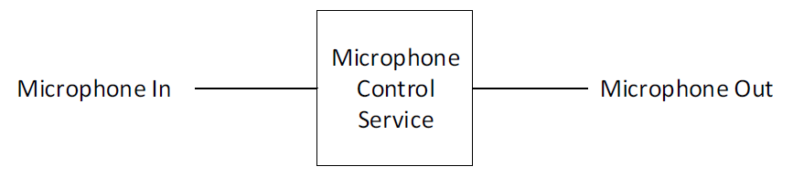
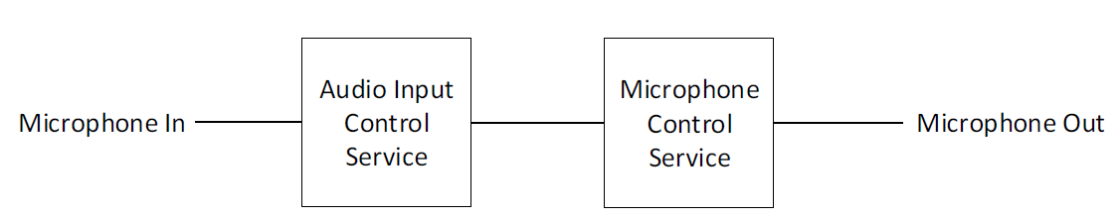
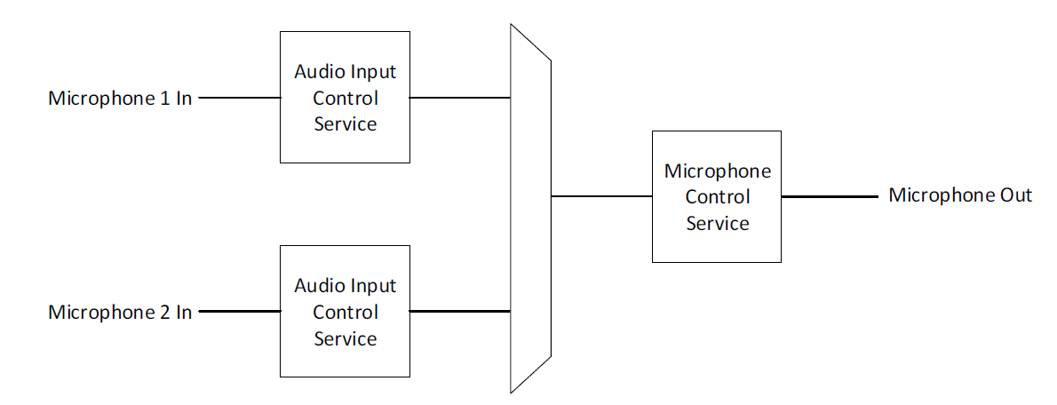
Introduction
Topology
MICS only
MICS + 1 AICS
MICS + 2 AICS

Slide 5
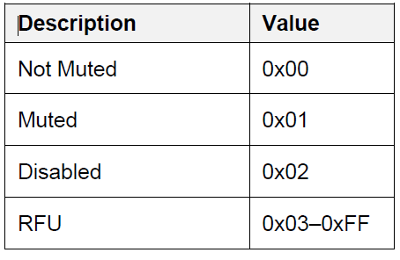
Service
Mute
Mandatory.
Read, Write, Notify
Disabled represents that mute commands are disabled (for example, via a local privacy switch or other means) and the microphone is muted.
When the Mute characteristic value is changed by the server or a client, then this value shall be notified to all clients that have enabled notifications
If the client writes a value of Disabled or RFU to the Mute characteristic, the server shall return error code Value Not Allowed (0x13)
If the client writes to the Mute characteristic when the Mute characteristic value is Disabled, the server shall return error code Mute Disabled (0x80)
Only a local change on the server may transition the value from Disabled to another value.

Slide 6
Thank you for listening!

